Slide 1
Ray Tracing in Entertainment Industry
Tanaboon Tongbuasirilai
Dept. Computer Science
Kasetsart University
Week 11
Monte Carlo sampling and Path tracing

Slide 2

Monte Carlo sampling and Path tracing
Monte Carlo sampling is a powerful technique used to randomly sample from a probability distribution. It's like randomly throwing darts at a target, where the target represents the probability distribution, and the landing points of the darts represent the samples you draw. By analyzing the distribution of these samples, you can gain valuable insights into the underlying probability distribution.
Path tracing is a rendering technique in computer graphics that produces highly realistic images by simulating the physical behavior of light. It's a type of Monte Carlo method, meaning it uses random sampling to approximate the solution to a complex problem.
Notes:
Monte carlo algorithm = ?
Las vegas algorithm = ?
Light transport problem → Rendering equation → path equation

Slide 3

Monte Carlo method
It can be used to solved
Probabilistic problems
Particle transport
Communication systems
Population studies
Deterministic problems
The evaluation of integrals
The systems of algebraic equations
Partial differential equations
https://web.tecnico.ulisboa.pt/~mcasquilho/acad/theo/simul/Vujic.pdf

Slide 4

Examples
Games and Recreation:
Game strategy evaluation: Analyzing game strategies and potential outcomes in games like chess or Go.
Casino simulations: Modeling casino games to estimate odds and payouts.
Financial Modeling:
Asset pricing and risk assessment: Modeling the behavior of financial markets and assets to estimate prices, risks, and potential returns.
Option pricing: Determining the fair value of options contracts, considering underlying asset price volatility and time to expiration.
Notes:
Observe ! The problems have many parameters to consider.

Slide 5
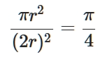
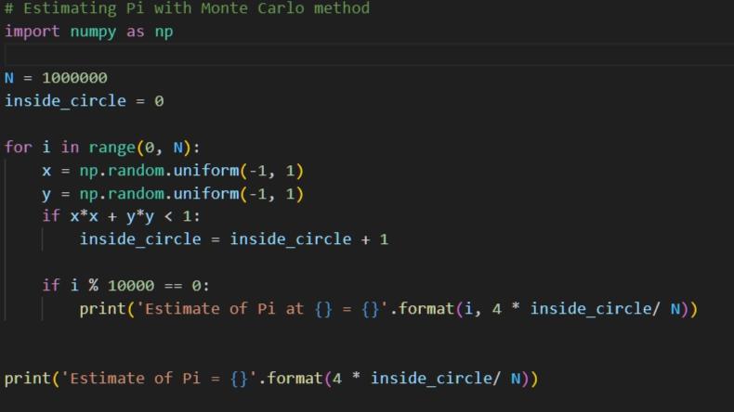
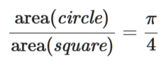

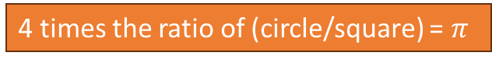
Estimating $π$
1
2
3
Drawing samples that fall inside the circle = the ratio of (circle/square).
This is a Monte Carlo method.
4 times the ratio of (circle/square) = $π$

Slide 6
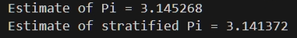
Stratified sampling
Notes:
Uniform random sampling vs Stratified sampling
Which one is closest ?

Slide 7
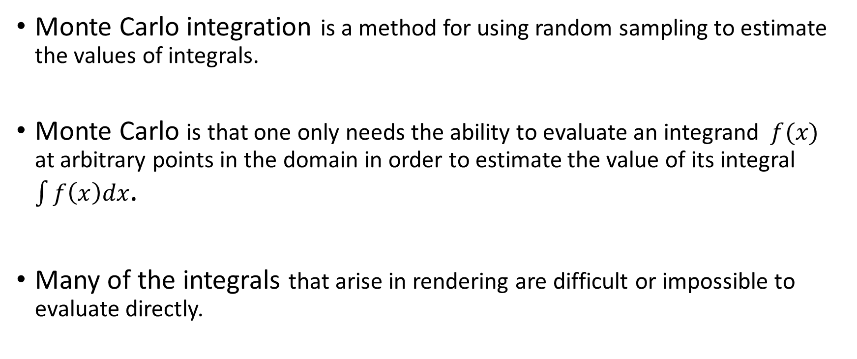
Monte Carlo integration
Monte Carlo integration is a method for using random sampling to estimate the values of integrals.
Monte Carlo is that one only needs the ability to evaluate an integrand $f(x)$ at arbitrary points in the domain in order to estimate the value of its integral $\int{f\left(x\right)dx}$.
Many of the integrals that arise in rendering are difficult or impossible to evaluate directly.
https://pbr-book.org/3ed-2018/Monte_Carlo_Integration
Notes:
One of the applications using Monte Carlo method = Monte Carlo integration
One condition is f(x) must be found (exist).

Slide 8
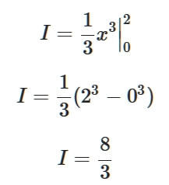
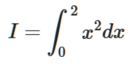
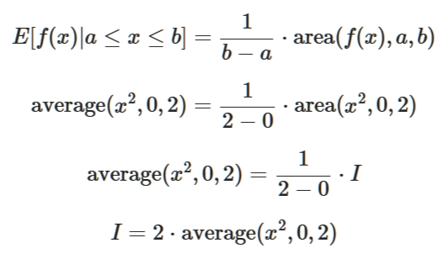
Solving an Integral equation
Closed form solution
Monte Carlo solution
Notes:
Example the integral solutions.
We define that the Expected value of the function f(x) in the domain = averaging over area of the integrand.
Area = the solution we want to find = I.
Thus, we get a form of Monte carlo integral solution = (b-a) * average of f(x) when sampling in the domain [a,b].

Slide 9
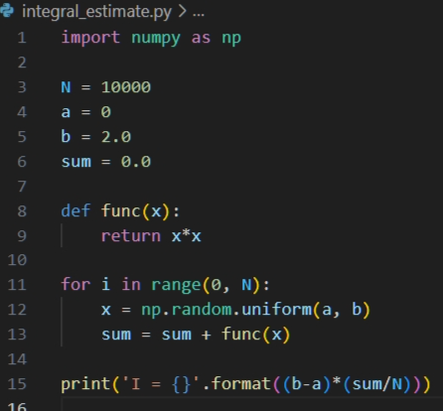
Integral estimation with a Monte Carlo method
This function can be arbitrary function.

Slide 10
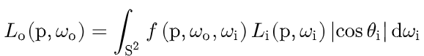
Integrator ?
- No analytical solution.
- Turning the problem into a numerical method.
- Monte Carlo method is applied.
We would like to solve this integral.
Notes:
Back to our rendering equation.
Can we evaluate all the functions ?
Do we have w_o, w_i, p ? → yes we have all those.

Slide 11
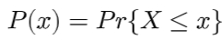
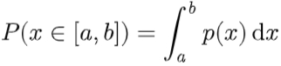
Probability review
Random variable X
Discrete
Continuous
Probability Density Function (PDF), p(x)
Discrete random variable → discrete function
Continuous random variable → continuous function
Cumulative Distribution Function (CDF), P(x)
Notes:
Discrete → point-wise
Continuous → cont-function
Notations differ between discrete – continuous.

Slide 12
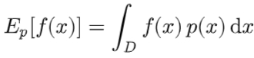
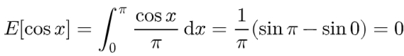
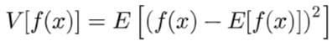
Expected value and Variance
The expected value of a function is defined as the average value of the function over some distribution of values over its domain.
The variance of a function is the expected squared deviation of the function from its expected value.
Notes:
Definition and mathematical definition.
E[cos x] → example

Slide 13
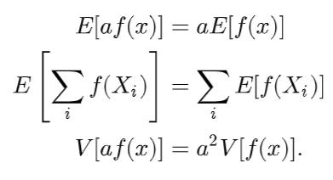
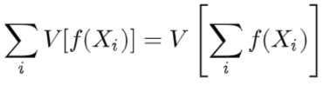
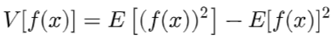
Properties of the expected value and variance
Notes:
Top arrow – extract the functions inside the expected value → apply the property (top)
Class participation → top arrow, bottom arrow
https://prvnk10.medium.com/the-variance-of-a-random-variable-2654a42adb72

Slide 14
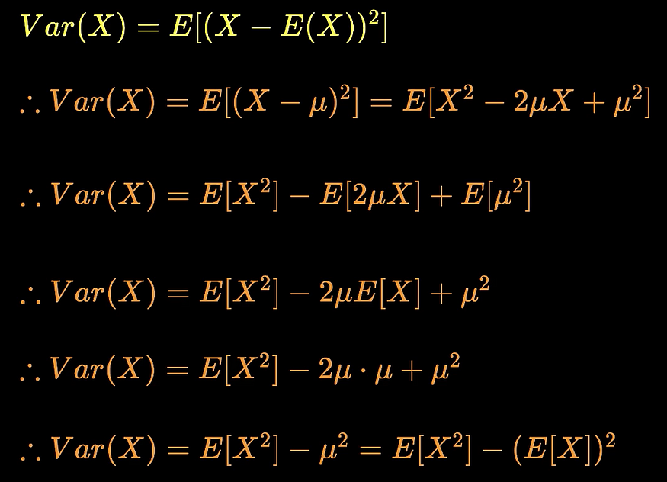
Derivation

Slide 15
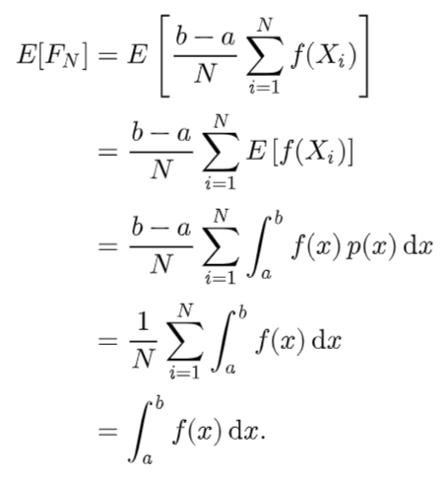
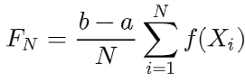
Estimator of the integral
Previous slides we have this estimator.
Proof of the estimator
Uniform PDF
Notes:
Lef eq. → Estimator from previous code – slide 8-9.
To show that the estimator is a solution of the integral → We find the expected value of the estimator such that its value is the integral.

Slide 16
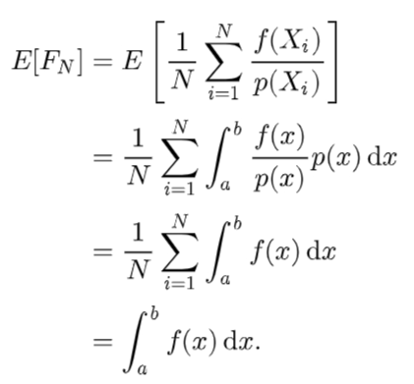
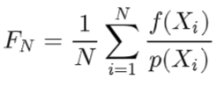
The estimator of the integral for arbitrary PDF
Notes:
In case we have an arbitrary PDF.

Slide 17
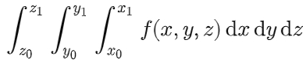
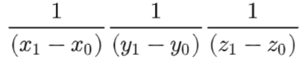
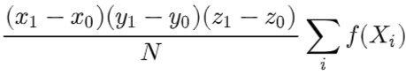
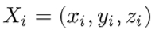
Multiple integral
Random sample
Uniform joint PDF
The estimator
Notes:
3 things to consider for a multiple integral form
A set of random samples. → drawn upon the PDF
A Joint PDF.
An estimator.
!!! This is the case when uniform pdf is employed.

Slide 18
How to draw random samples from arbitrary PDF ?
The inversion method
The rejection method
Notes:
What about the PDF is arbitrary ???

Slide 19
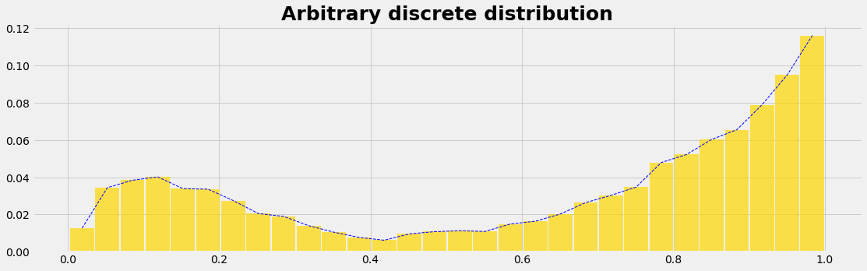
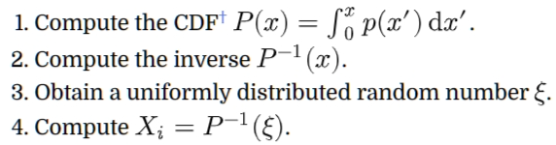
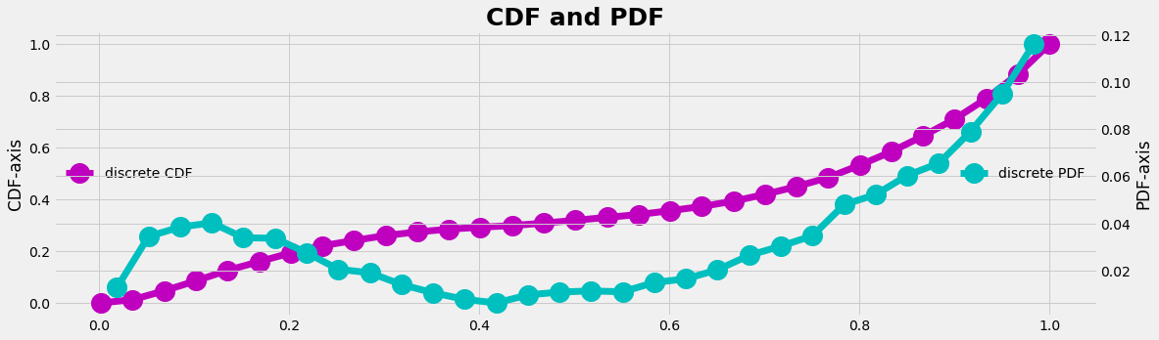
The inversion method
0
There are 4 steps when do random sampling with the inversion method.
1
https://alpynepyano.github.io/healthyNumerics/posts/sampling_arbitrary_distributions_with_python.html
Notes:
This example pdf is not a uniform, or a gaussian.

Slide 20
2-3
4
Sampling with Uniform PDF [0,1]
Obtain a random sample according to the arbitrary PDF.

Slide 21
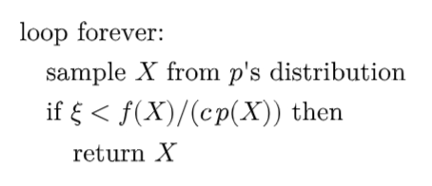
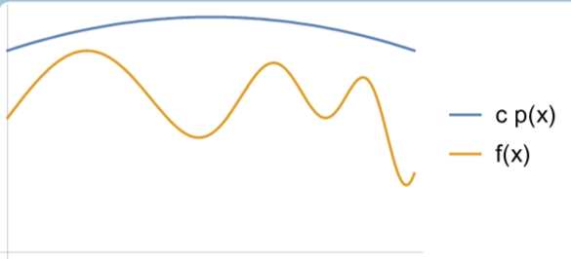
The rejection method
Notes:
Las vegas algorithm ?

Slide 22
Path tracing
By integrating the Monte Carlo method for solving the rendering equation, the renderer becomes a path tracer.
This means Path Tracing involves in using random sampling techniques and probability density functions to obtain the final render images.
Notes:
What actually is path tracing ?

Slide 23
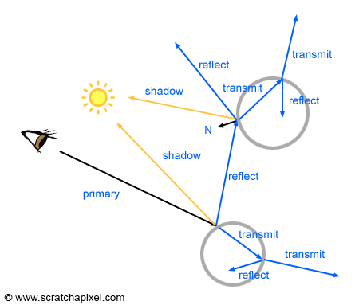
Whitted Ray Tracing
Only 1 ray per pixel !
www.scratchapixel.com/lessons/3d-basic-rendering/ray-tracing-overview/light-transport-ray-tracing-whitted.html

Slide 24

Path tracing Vs Ray tracing [User perspective]
Ray Tracing vs. Path Tracing: Unraveling the Differences
https://www.youtube.com/watch?v=3YIXLLrm7fo

Slide 25

Path Tracing basics
Rendering Lecture 04 - Path Tracing Basics (youtube.com)
https://www.youtube.com/watch?v=w36xgaGQYAY
Notes:
The following slides are from the lecture.
The following content is a brief of the lecture.

Slide 26
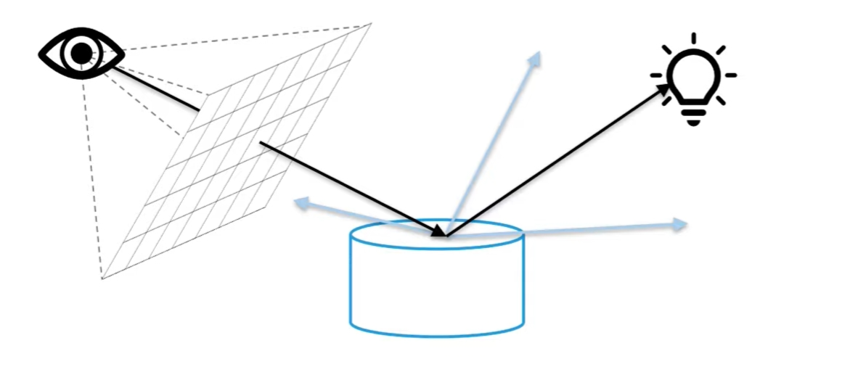
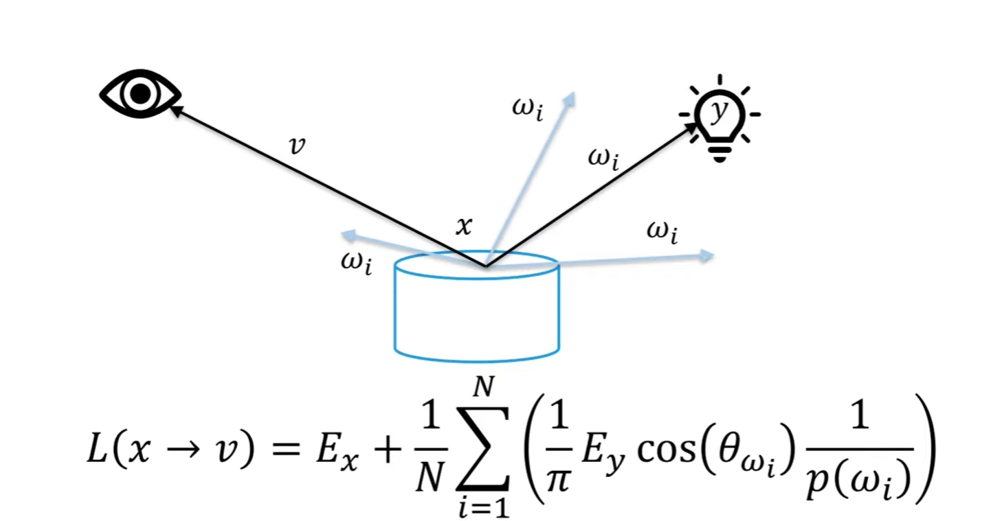
Path tracing - Direct lighting
Li
N dot L
Divided by a PDF
Notes:
Ey = emitted light from y
Divide by a pdf = monte carlo integration solution.

Slide 27
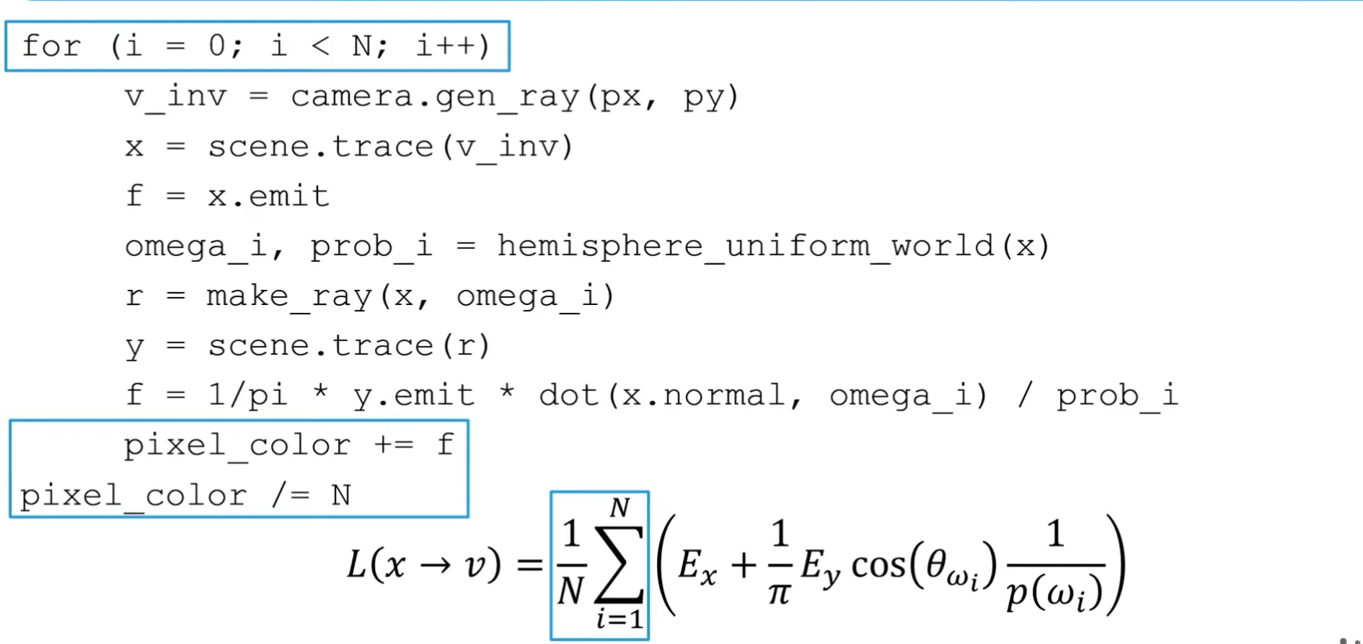
Notes:
The term L(x->v) is now then become a for loop.
Pixel_color = what we want to find.

Slide 28
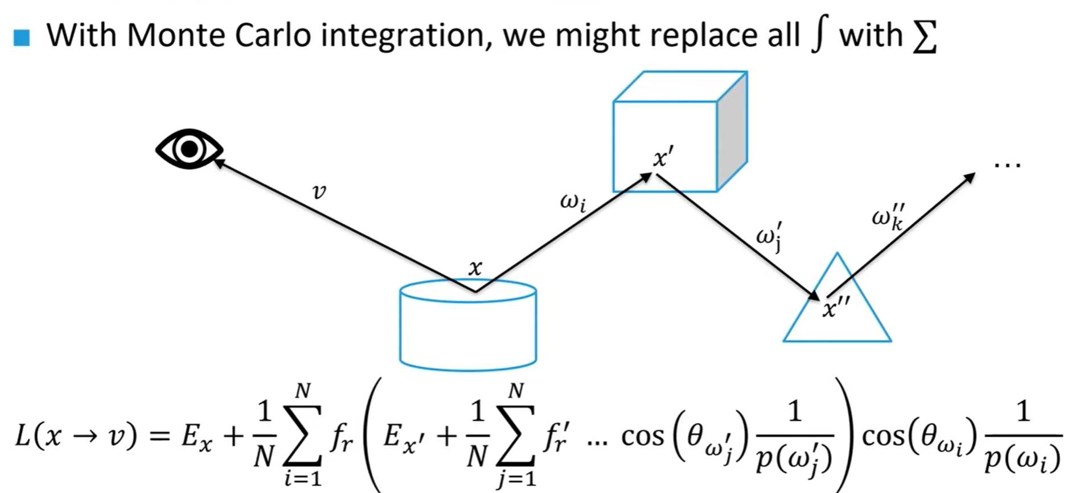
Path tracing – Indirect lighting

Slide 29
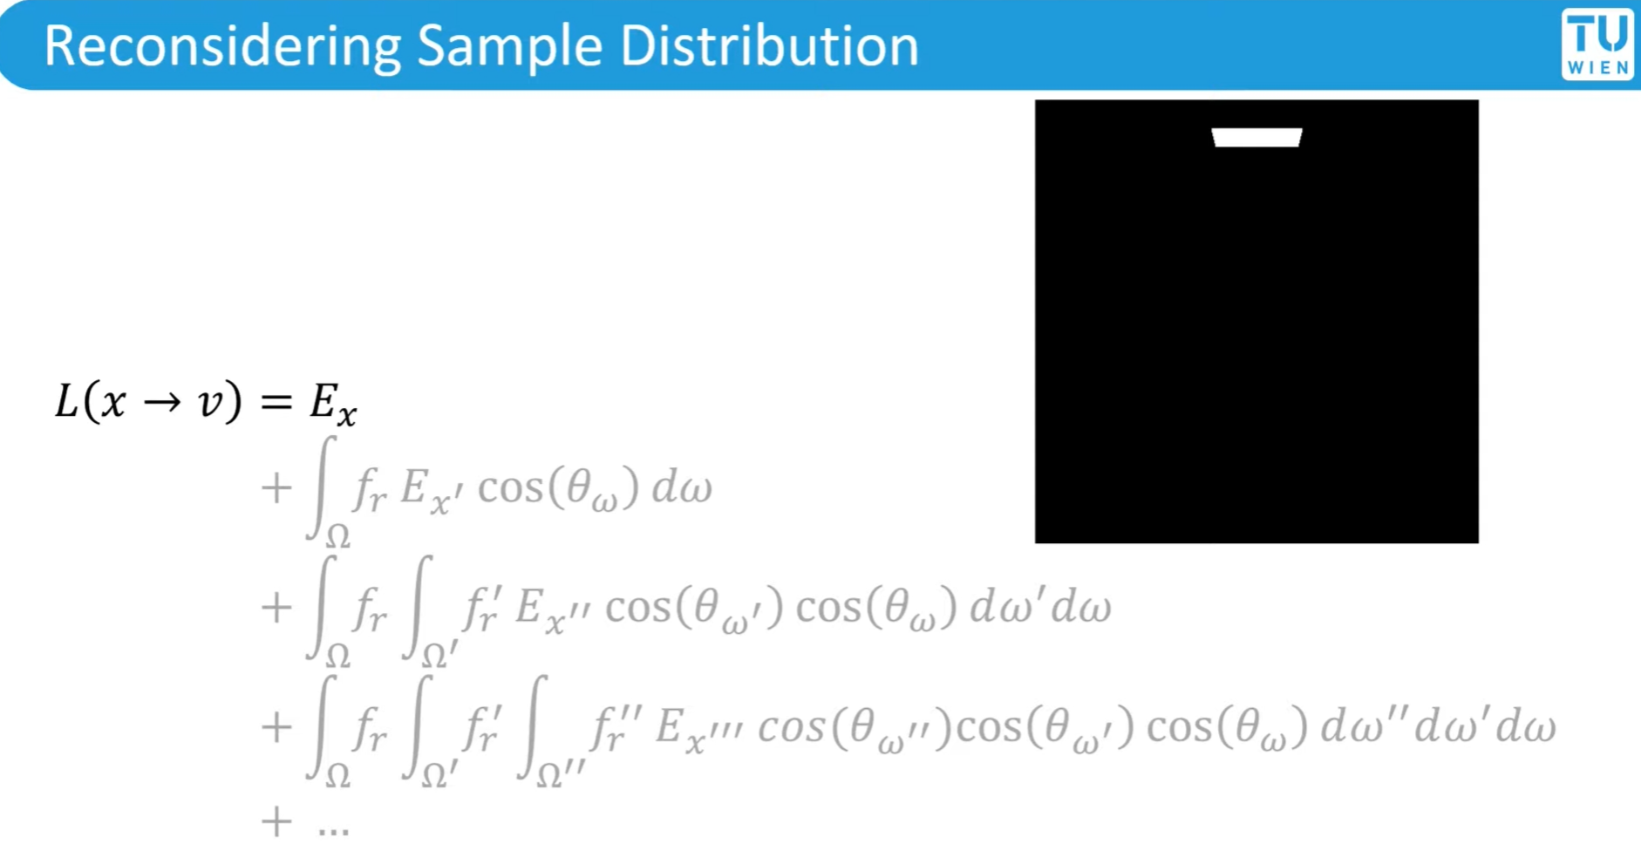

Slide 30
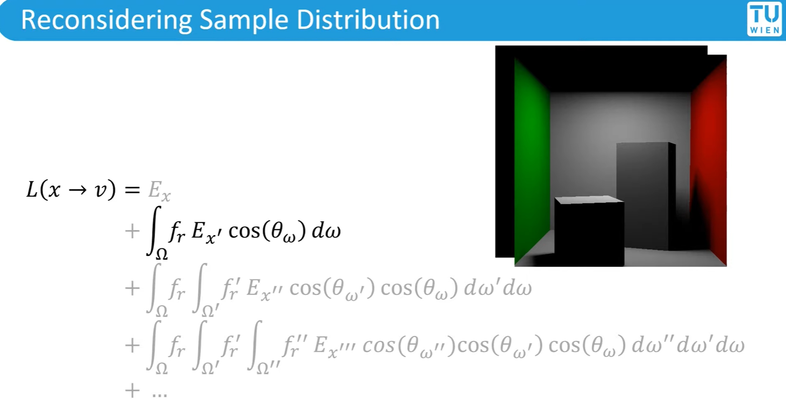

Slide 31
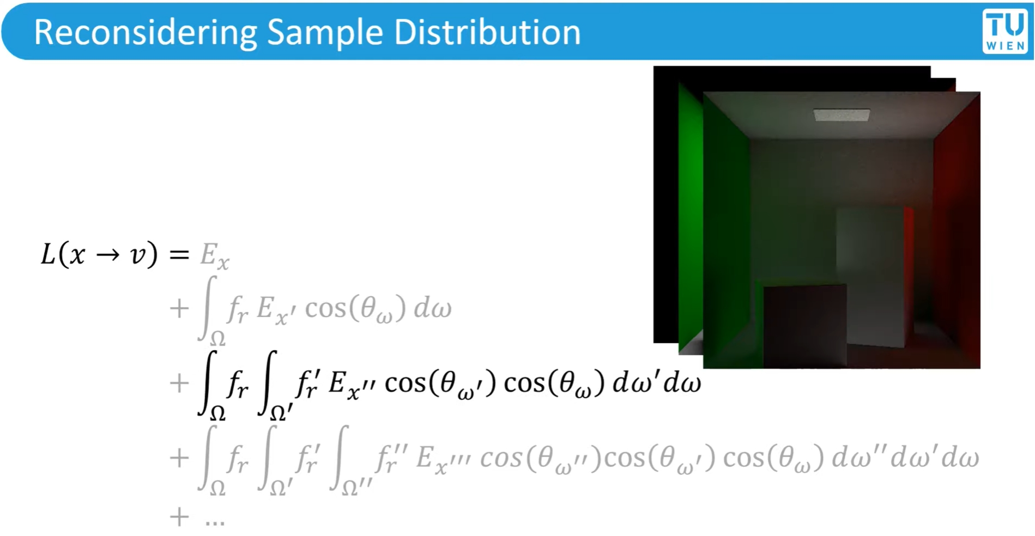

Slide 32
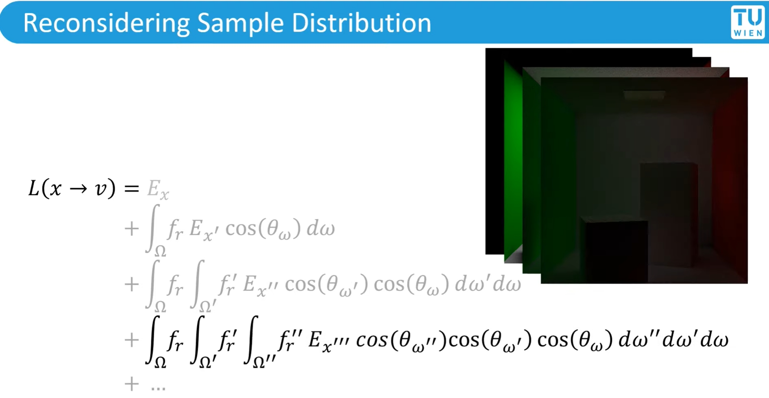

Slide 33
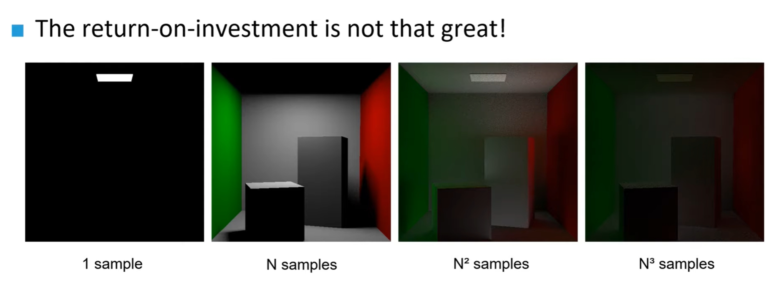

Slide 34
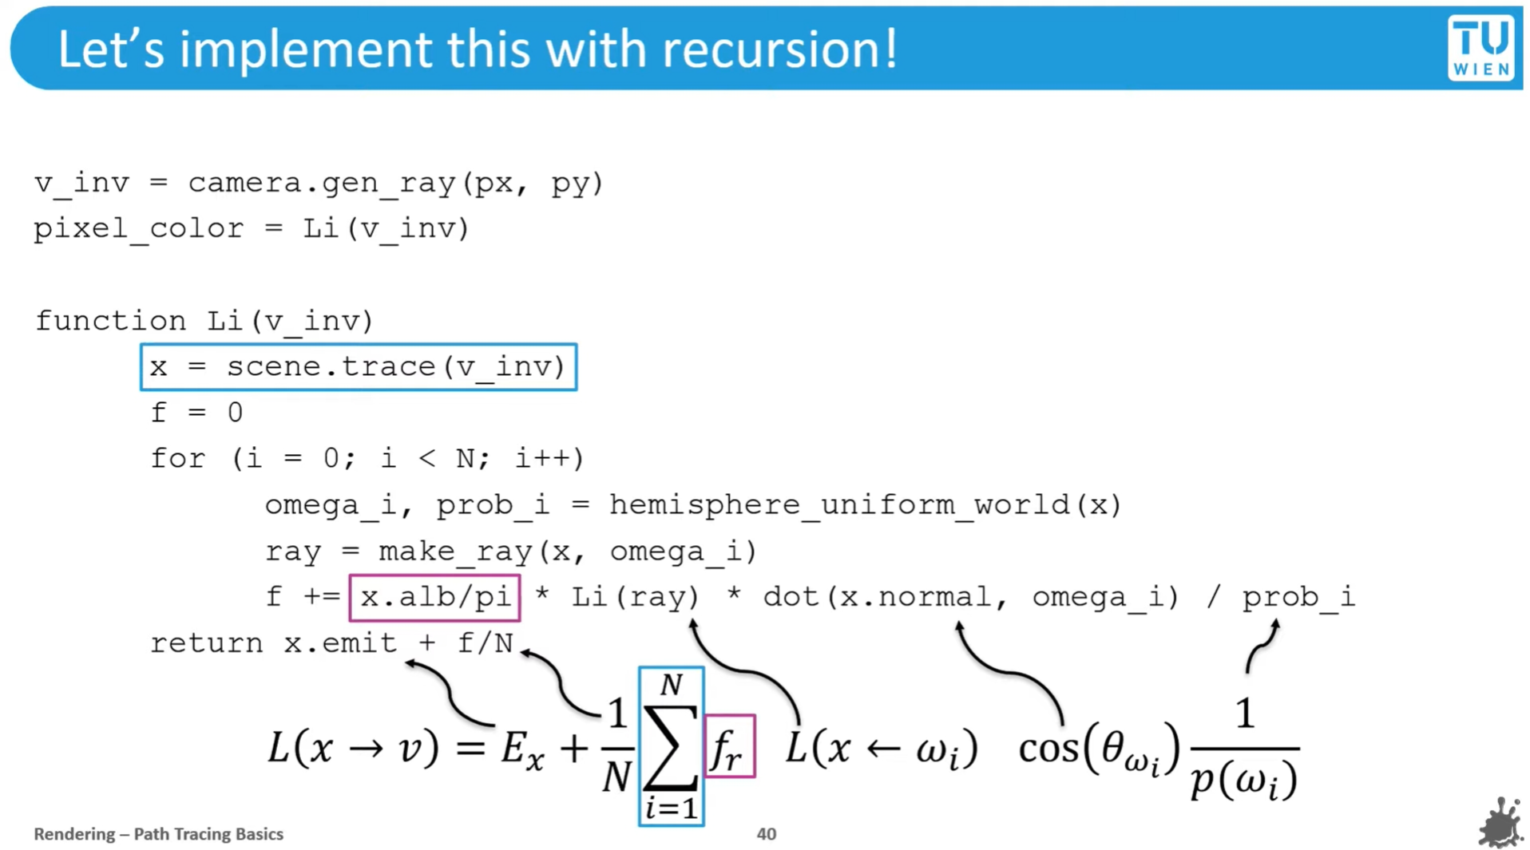

Slide 35
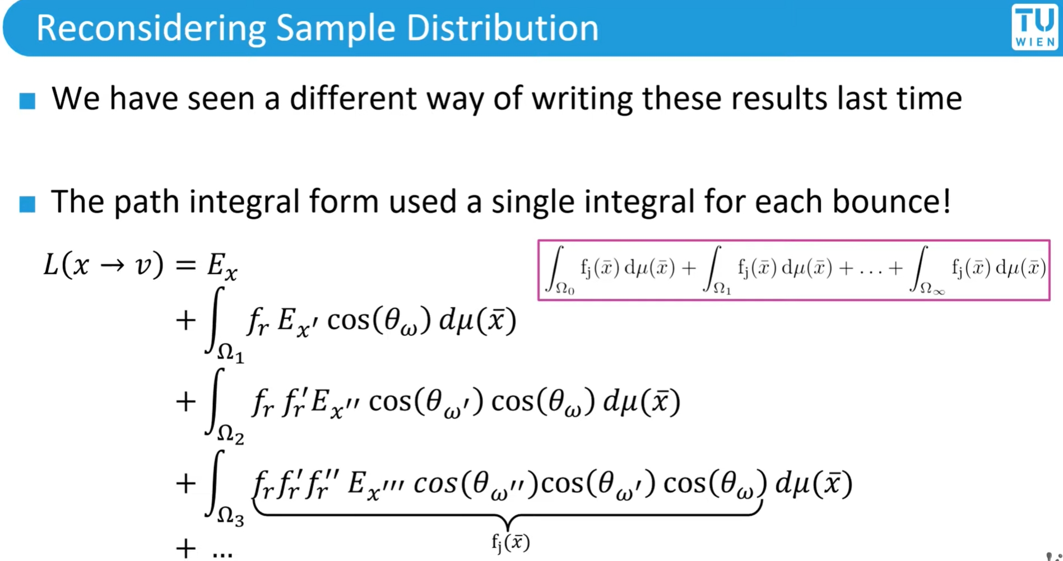

Slide 36
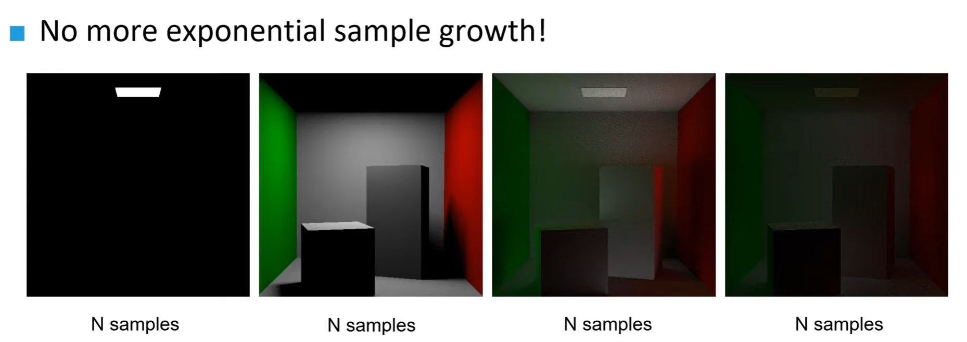

Slide 37
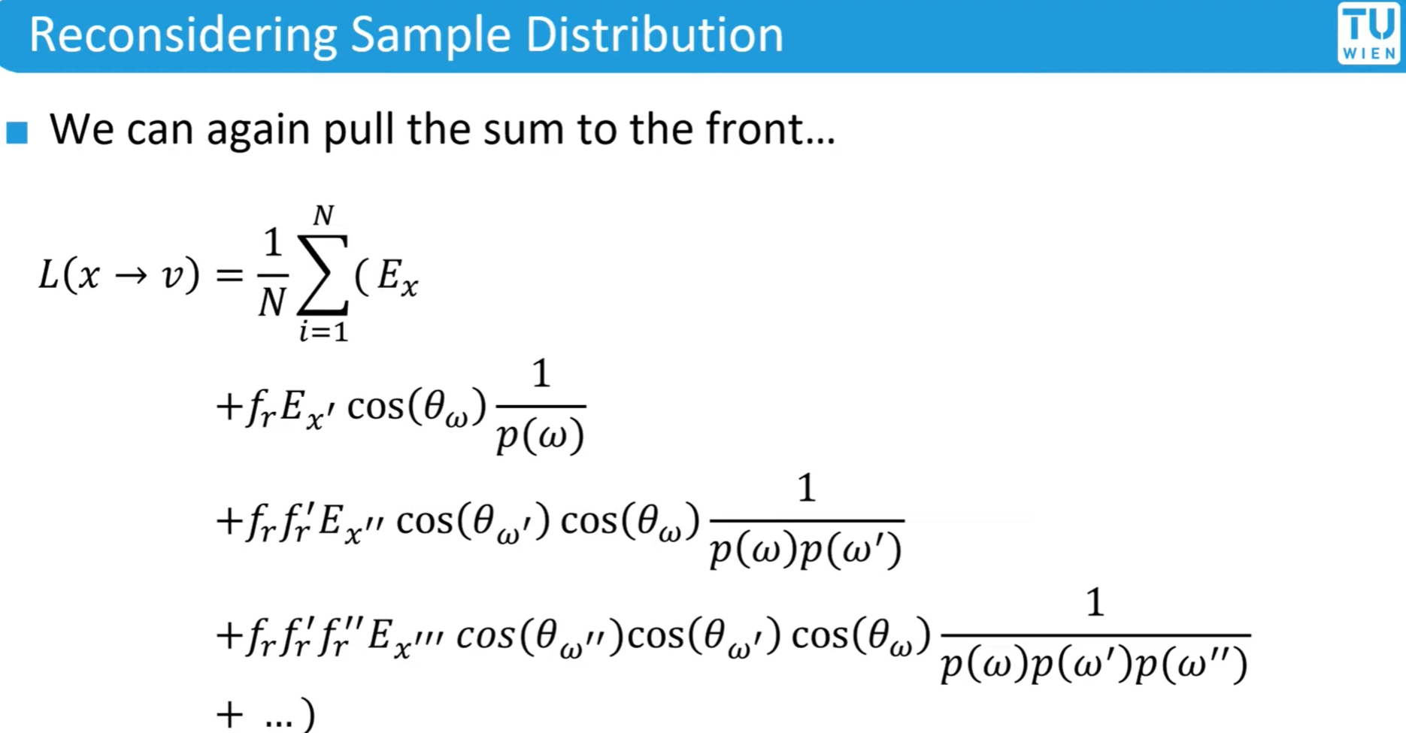

Slide 38
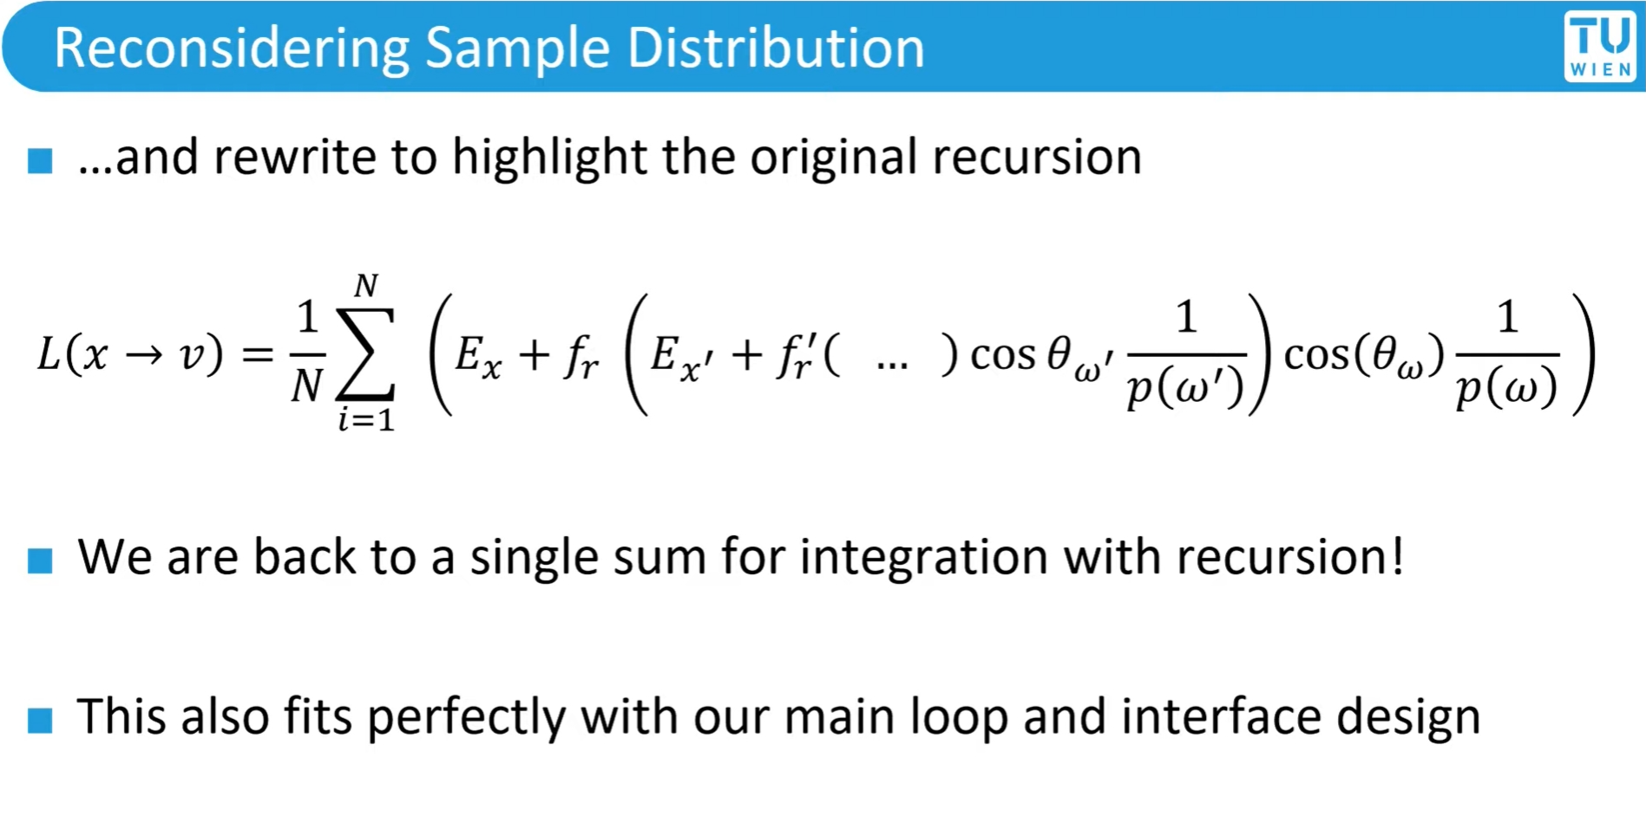

Slide 39
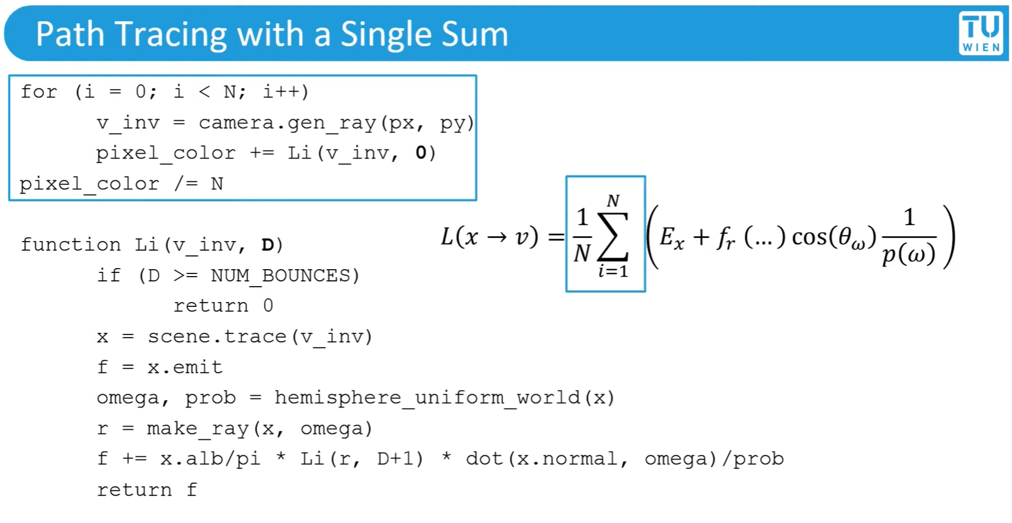

Slide 40
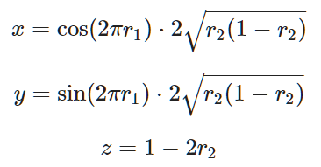



Recall week 09 : Uniform sampling on …
Sphere
hemisphere
$$r1 ∈\left[0,1\right]$$
$$r2 ∈[0,1]$$
$$r1 ∈\left[0,1\right]$$
$$r2 ∈[0,1]$$

Slide 41


Uniform sampling on hemisphere
The probability to derive the sampling on hemisphere is $p\left(ω\right)=\frac{1}{2π}$, see the derivation in 13.6.1 PBRT book.
The uniform sampling on sphere is $p\left(ω\right)=\frac{1}{4π}$.
Note that the probability is subjected to the solid angle $ω$.
However, the rendering equation has the cosine weighted term, choosing a PDF close to the integrand will result in faster convergence.
That means we want to choose $p\left(ω\right)∝cos⁡(θ)$.
We will talk about this issue in the next week. [Variance reduction]

